Slide 1

GROW
Feel More, Row More!
HCI Project
ISSA MOUAWAD & VIKTORIYA BODNAR
UniGe 2018

Slide 2
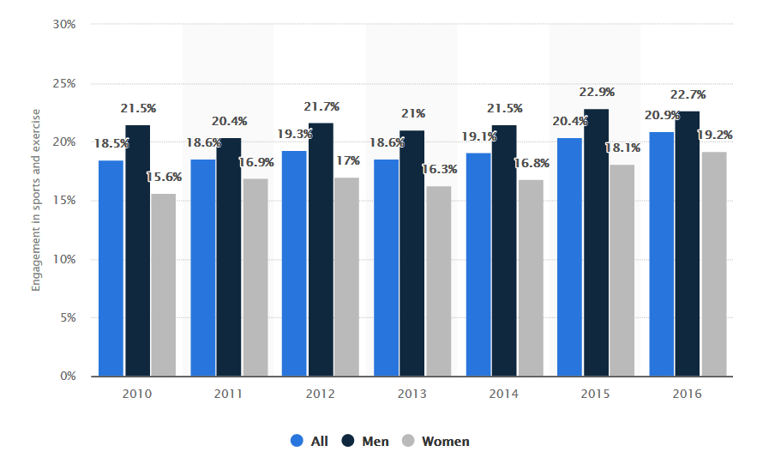
SPORTS IN OUR LIFE
Physical benefits
Health improvement
Building character value
Socializing
https://www.statista.com/statistics/189562/daily-engagement-of-the-us-poppulation-in-sports-and-exercise/

Slide 3
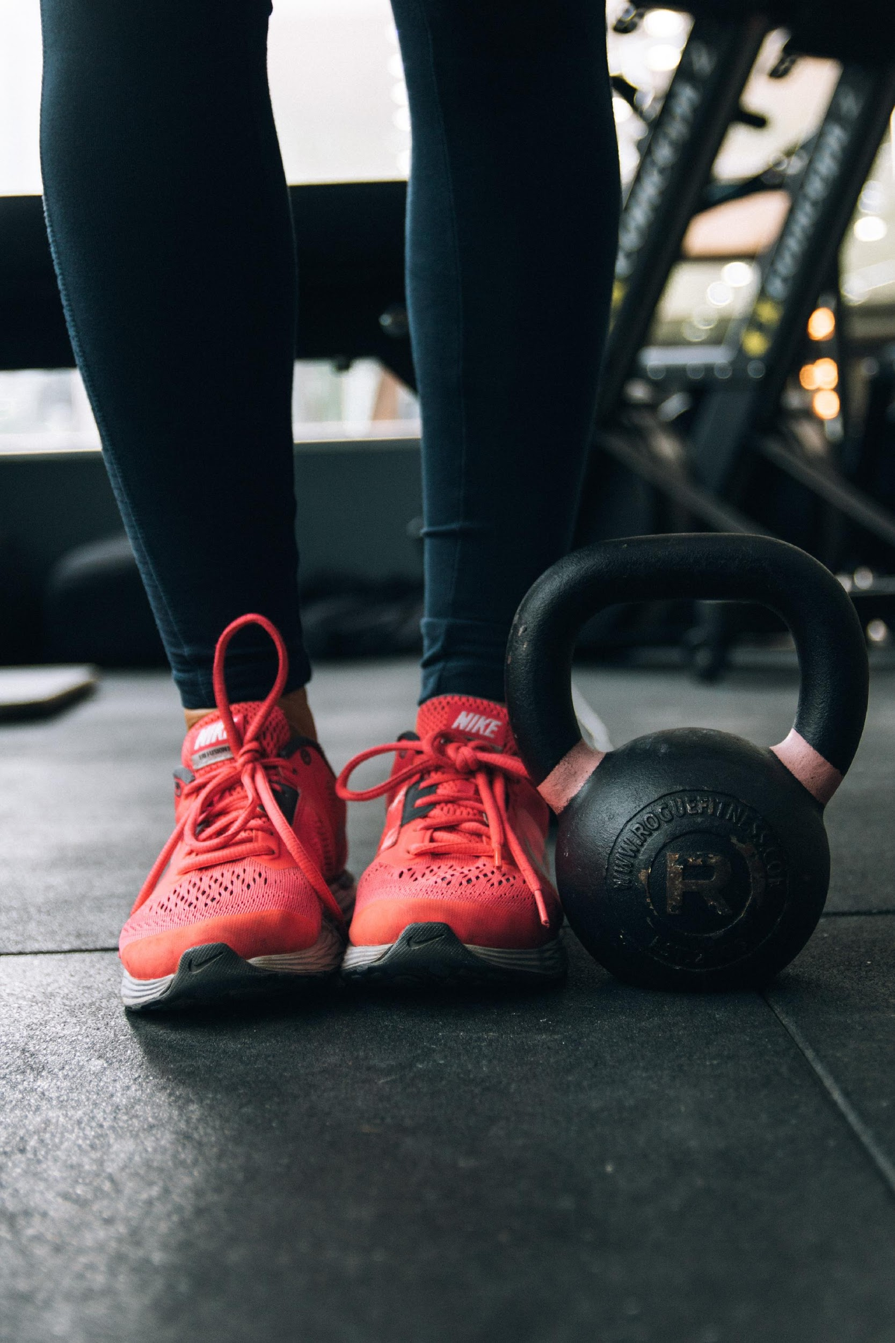
SPORTS IN OUR LIFE
Precise and coherent body movements
Beginners’ lack of knowledge → instructor/guide needed
Experts’ posed goals → monitoring and coaching required
Track the movements & give feedback
Exploiting visual/auditory/haptic channels

Slide 4
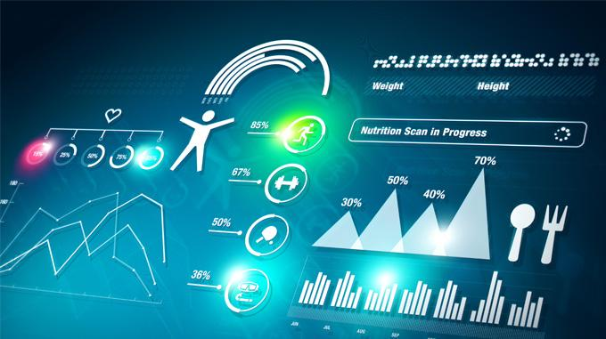
TECH IN SPORTS
Reduce human error and improve coaching
High-tech materials for records
Wearables for speed and distance tracking
Nano sensors for muscles and joints activity detection
AI for health monitoring, injuries prevention, performance analysis, virtual coaching
N.B. take into account doping fallacy

Slide 5
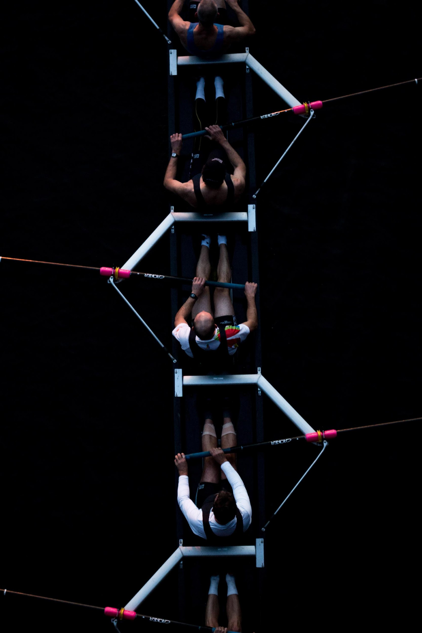
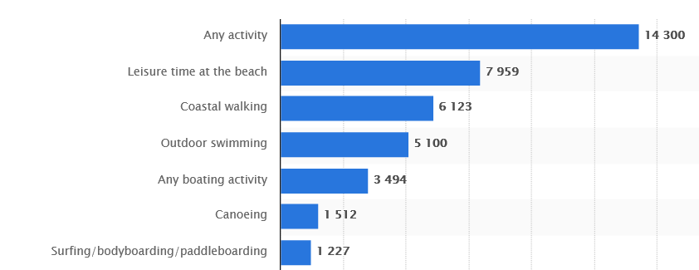
CASE STUDY: ROWING
Old Olympic Sport
Easy to learn, hard to master
Full-body movements with rotational aspects
Balance
Movement range/quality → speed & acceleration
Team-work → coordination & synchronization
A lot of research for smart solutions
https://www.statista.com/statistics/606772/outdoor-water-sports-activity-by-participation-united-kingdom/

Slide 6

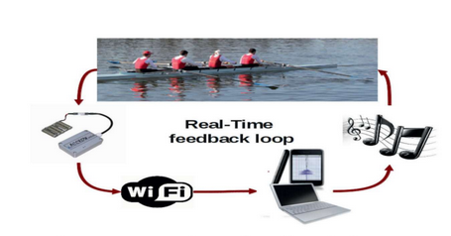

STATE OF ART
Interactive Sonification in Rowing: an Application of Acoustic Feedback for On-Water Training[1]
single rower
measurements: boat acceleration & speed
Sofirow HW & SW, loudspeakers( ~AccrowLive)
remote analysis
pitch to encode the acceleration feedback
perceived as functional and supportive

Slide 7
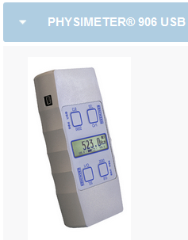
STATE OF ART
Influence of acoustic feedback on boat speed and crew synchronization in elite junior rowing[2]
team scenario
measurement: force applied to the oars, angle of movement, velocity, acceleration, heart rate, blood lactate
Mobile Measuring System, sensors attached to the oars, Sofirow, HR monitors, loudspeakers
pitch as an acceleration feedback
improvement in synchronization

Slide 8
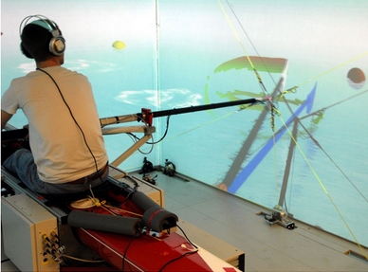
STATE OF ART
Sonification and haptic feedback in addition to visual feedback enhances complex motor task learning[4]
virtual reality rowing
measurements: oar speed & trajectory
simulation by CAVE, Unity, MATLAB, screens, headphones
environmental feedback + sonification of the oar speed + haptic oar drift resistance
multimodal feedback enhanced the learning and immersion of the participants

Slide 9

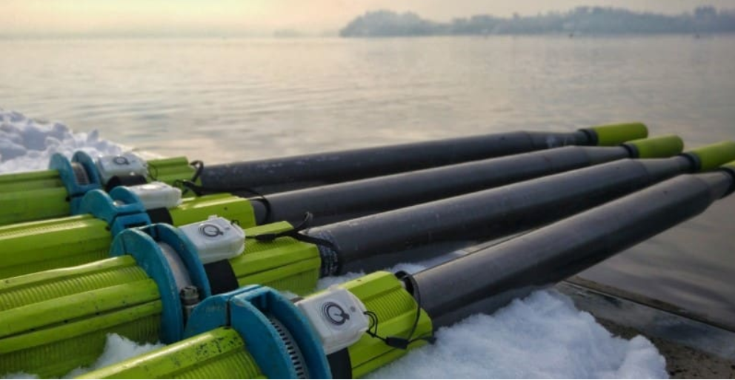
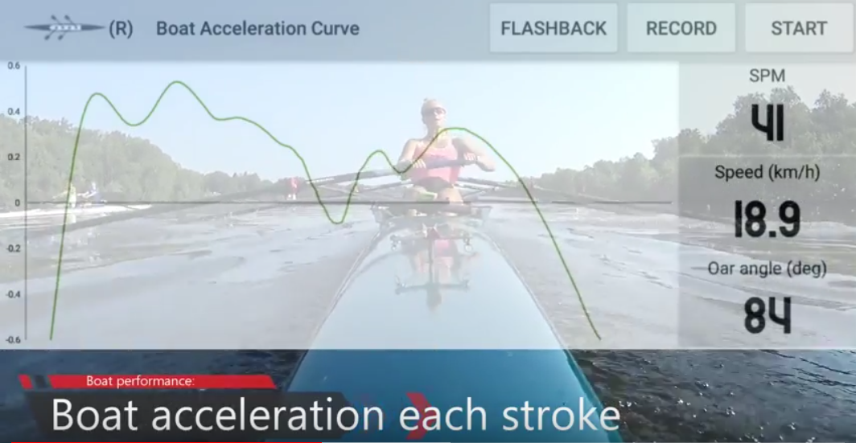
MARKET ANALYSIS
Rowing Performance
Android
able to connect to several sensors(boat-mounted, arm-mounted, oar-mounted)
collect measurements related to the angles and trajectory of movements
objective is to monitor and log the rowing session for further analysis

Slide 10
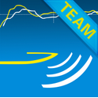
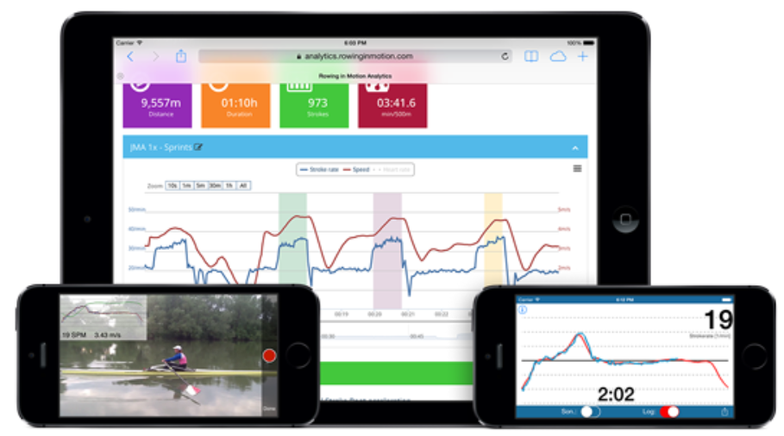
MARKET ANALYSIS
Rowing in Motion
iOS, Android
able to track and log acceleration, speed, and stroke-rate.
measurements from the mobile sensors(accelerometer, GPS)
provides support for acceleration sonification
provides interfaces for rowers and coaches

Slide 11
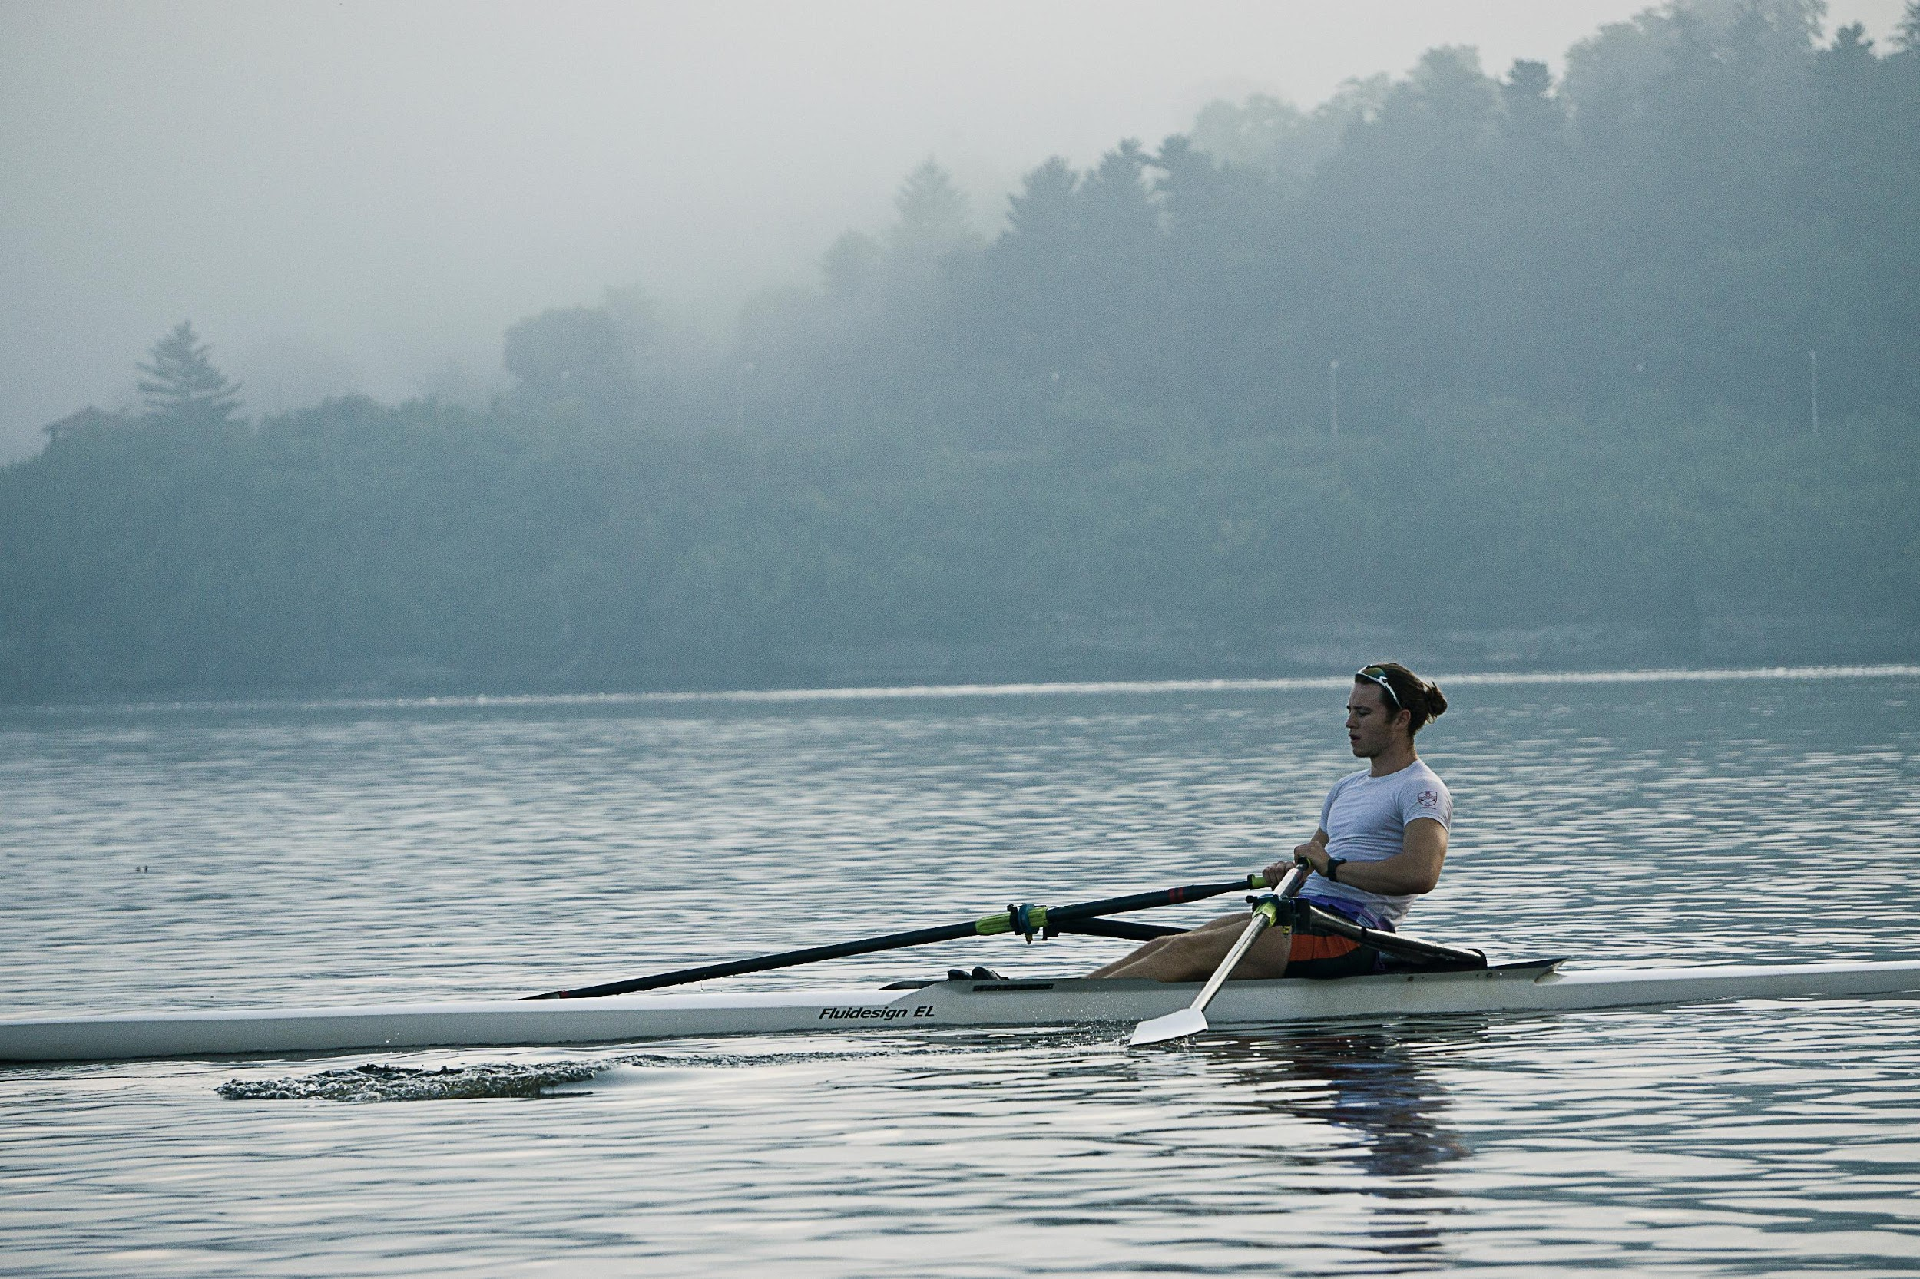
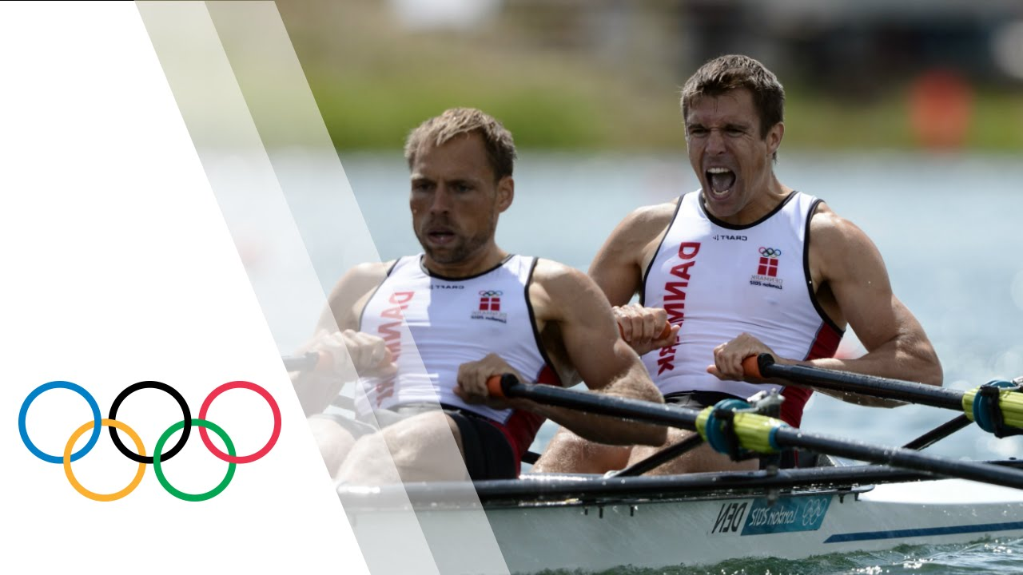
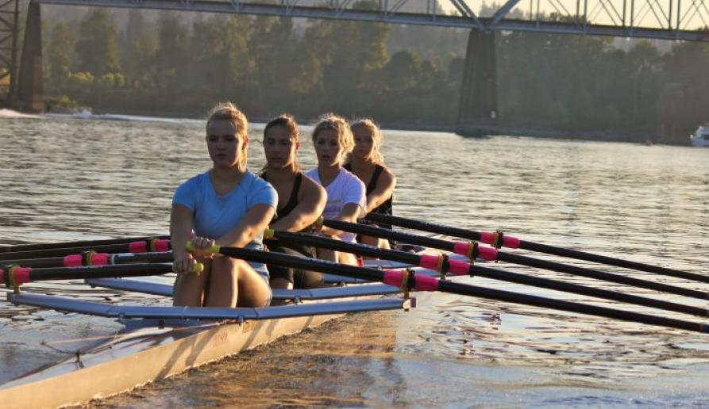
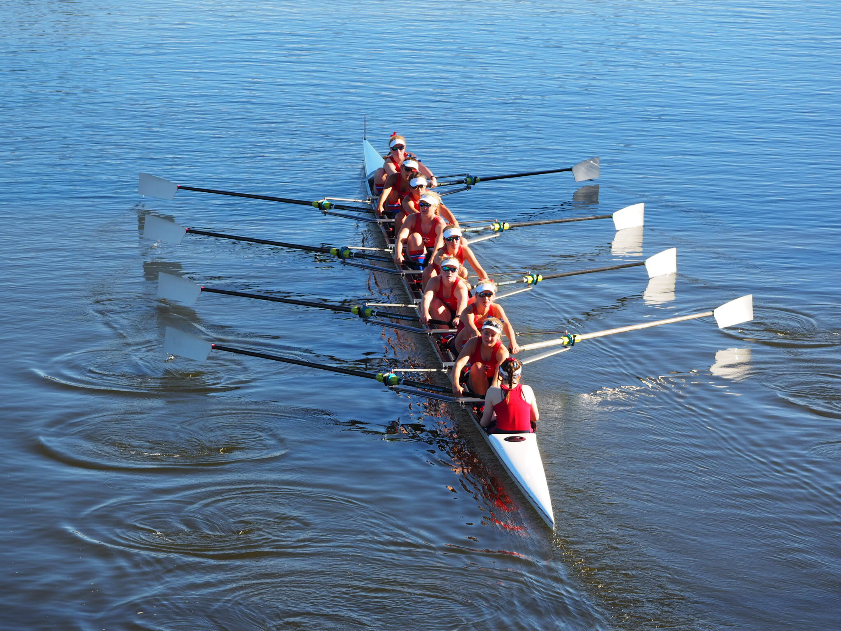
OUR IDEA

Slide 12

OUR GOALS
PROPOSED SOLUTION
Neuroscience research→ strong physiological connection between the auditory and motor system across a variety of cortical, subcortical, and spinal levels.
Support different kinds of rowing
Build beginner friendly interface
Improve quality of muscular activity
Enhance Correct breathing
Performance measurement
Team synchronization
Multimodality with Auditory and Haptic Feedbacks

Slide 13

USER ANALYSIS
Beginners
Correct movements
Consistent breathing
Arms synchronization
Experts
Performance improvement
Team synchronization

Slide 14
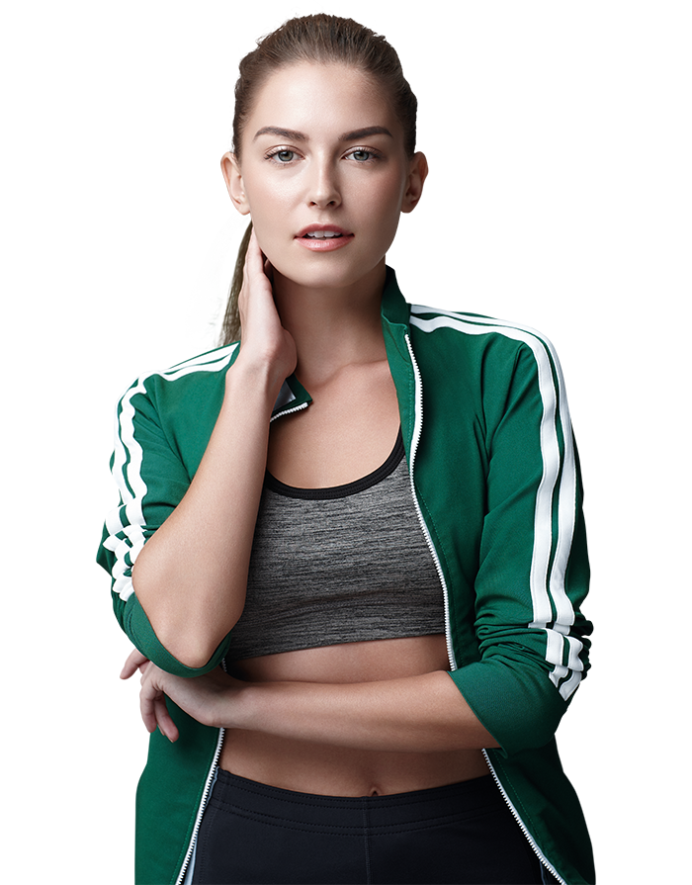
USER ANALYSIS - Personas
Paola:22 yrs
beginner
rowing as a hobby
Goals:
Rowing correctly
Easy-to-use solution
Improved balance
Teamwork rowing made easier
Frustrations:
Difficulty to maintain balance with large stroke-per-minute
Oar control

Slide 15

USER ANALYSIS - Personas
Steven :26 yrs
expert
Competitive rowing
Goals:
Improved performance
Optimized team synchronization
In-depth analysis of session performance
Frustrations:
Unavailability of a simple-to-use solution

Slide 16

TASK ANALYSIS - Facilitate & Improve Rowing Experience
Effectively Teach Beginners
Efficiently Support Experts
Improve
Team Synchronization
Correct and
Quality
Movements
Boosting
Performance
Member
Coordination
Monitoring of
- Muscular Activity
- Oar Trajectory
- Breathing
Measurements
Recording

Slide 17
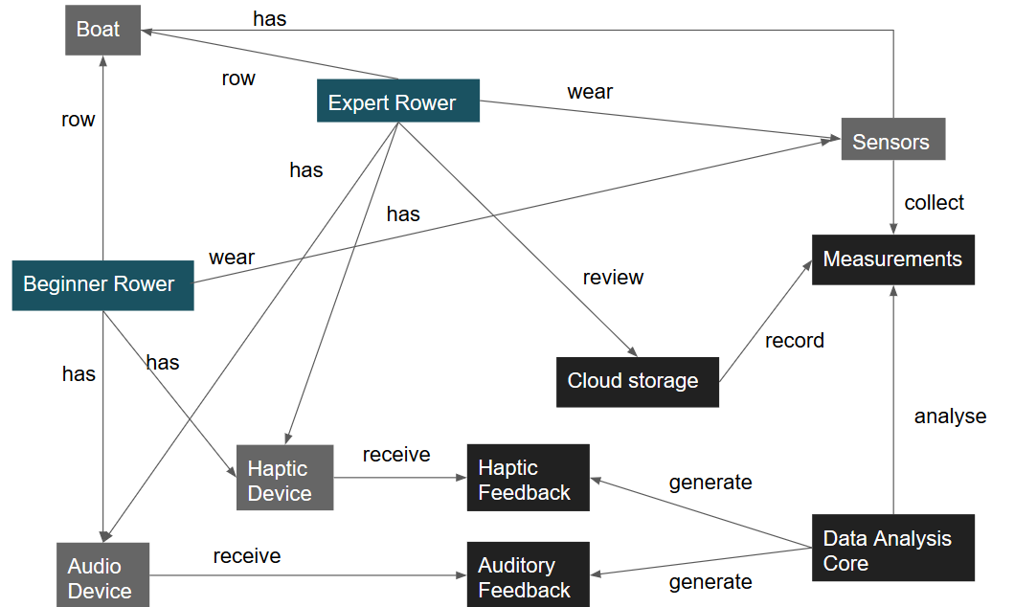
DOMAIN ANALYSIS
People: Beginner, Expert
Physical objects: Boat, Sensors, Haptic Devices, Audio Device
Informational objects: Measurements, Data Analysis Core, Cloud storage, Auditory and Haptic Feedbacks.

Slide 18

REQUIREMENTS
Functional:
Mobile interface for on-site interaction
Web-based interface for further analysis
Two operation modes: beginner, expert
Necessary gadgets for body, boat and oar metrics
On-the-fly data analysis
Real time feedback
Auditory for movement quality and correctness
Tactile for synchronization
Non functional :
Minimal and intuitive design
Suitable for high lighting conditions
Gadgets with minimum set-up hassle
Sensors and Feedback devices that do not impede the rower experience
High throughput of uploading data to Cloud
Synchronized and reliable storage

Slide 19
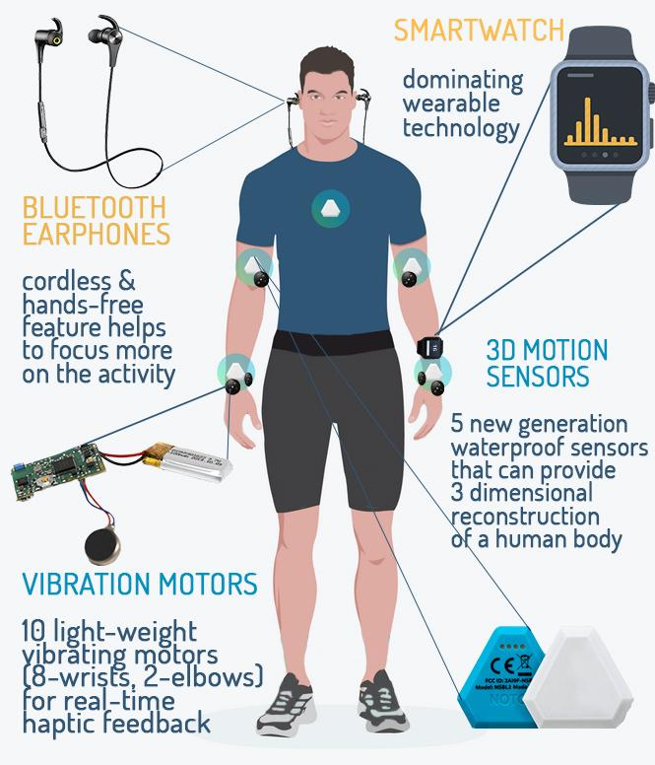
1 SCENARIO - BEGINNER
SmartWatch - setting the session
3D motion sensors - measurements collection and further 3D reconstruction of the body
Vibration motors - haptic feedback of body motions
Bluetooth earphones -
Single rower - auditory feedback of hands synchronization
Team - auditory feedback of team synchronization

Slide 20

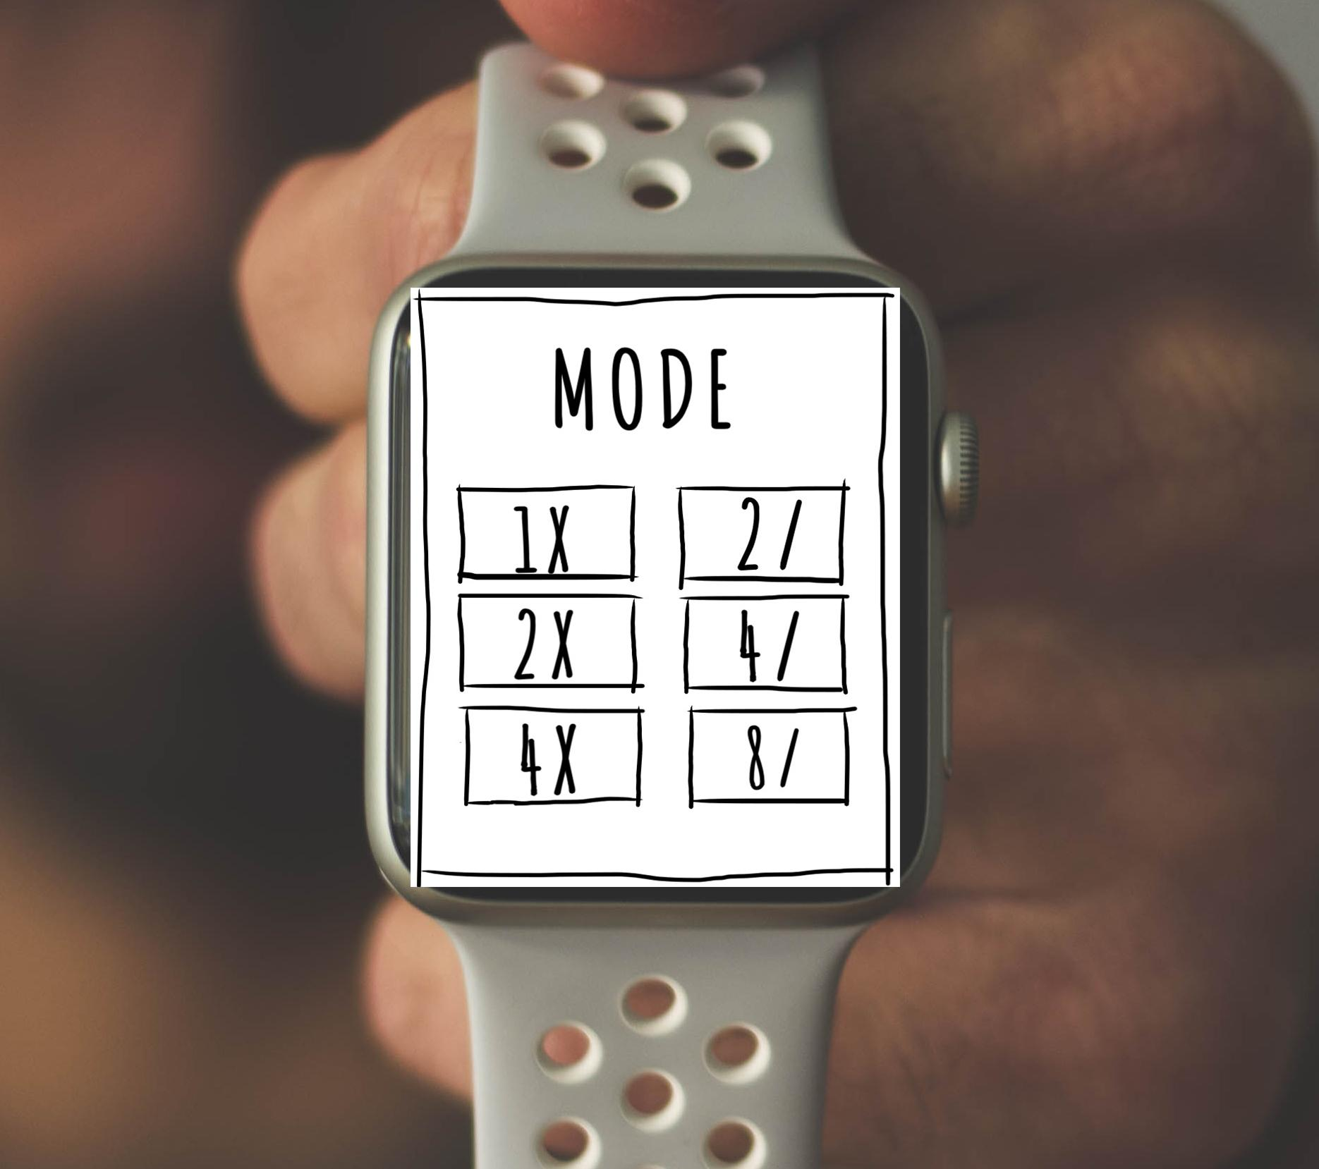
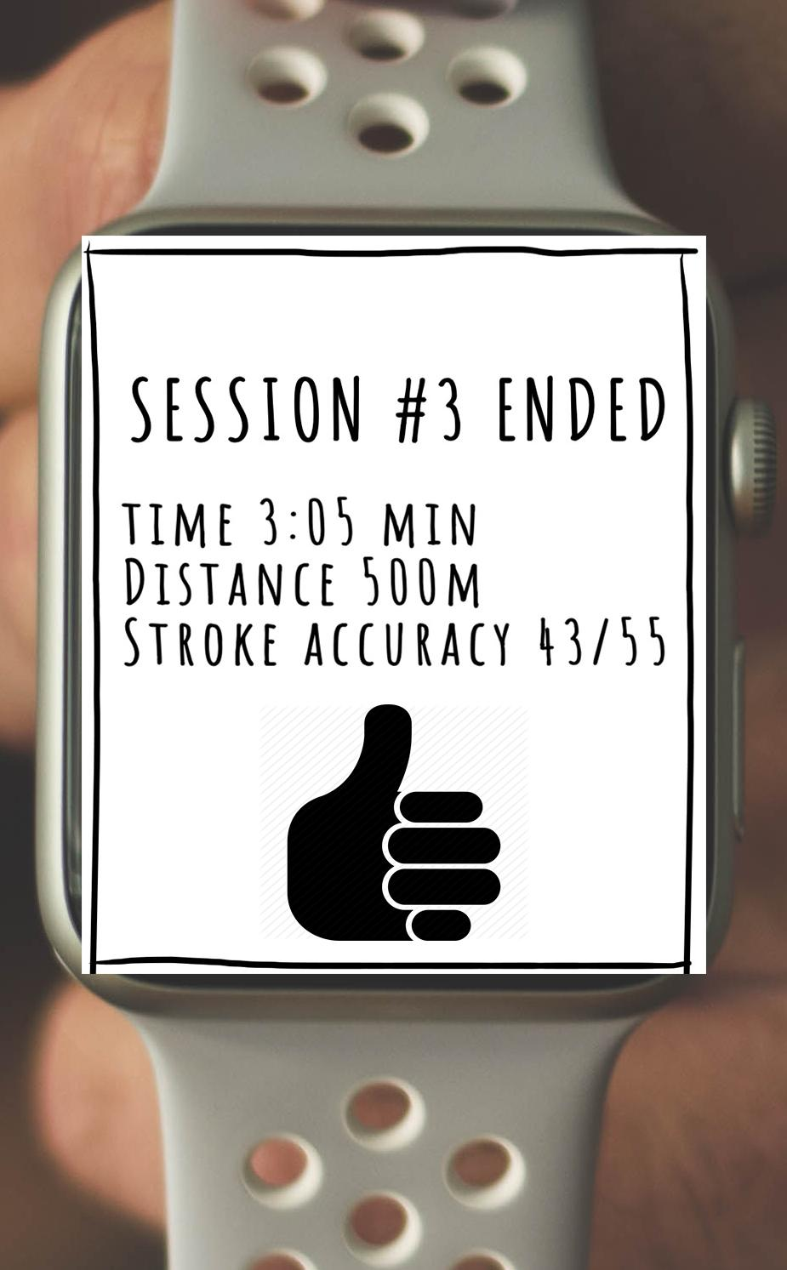

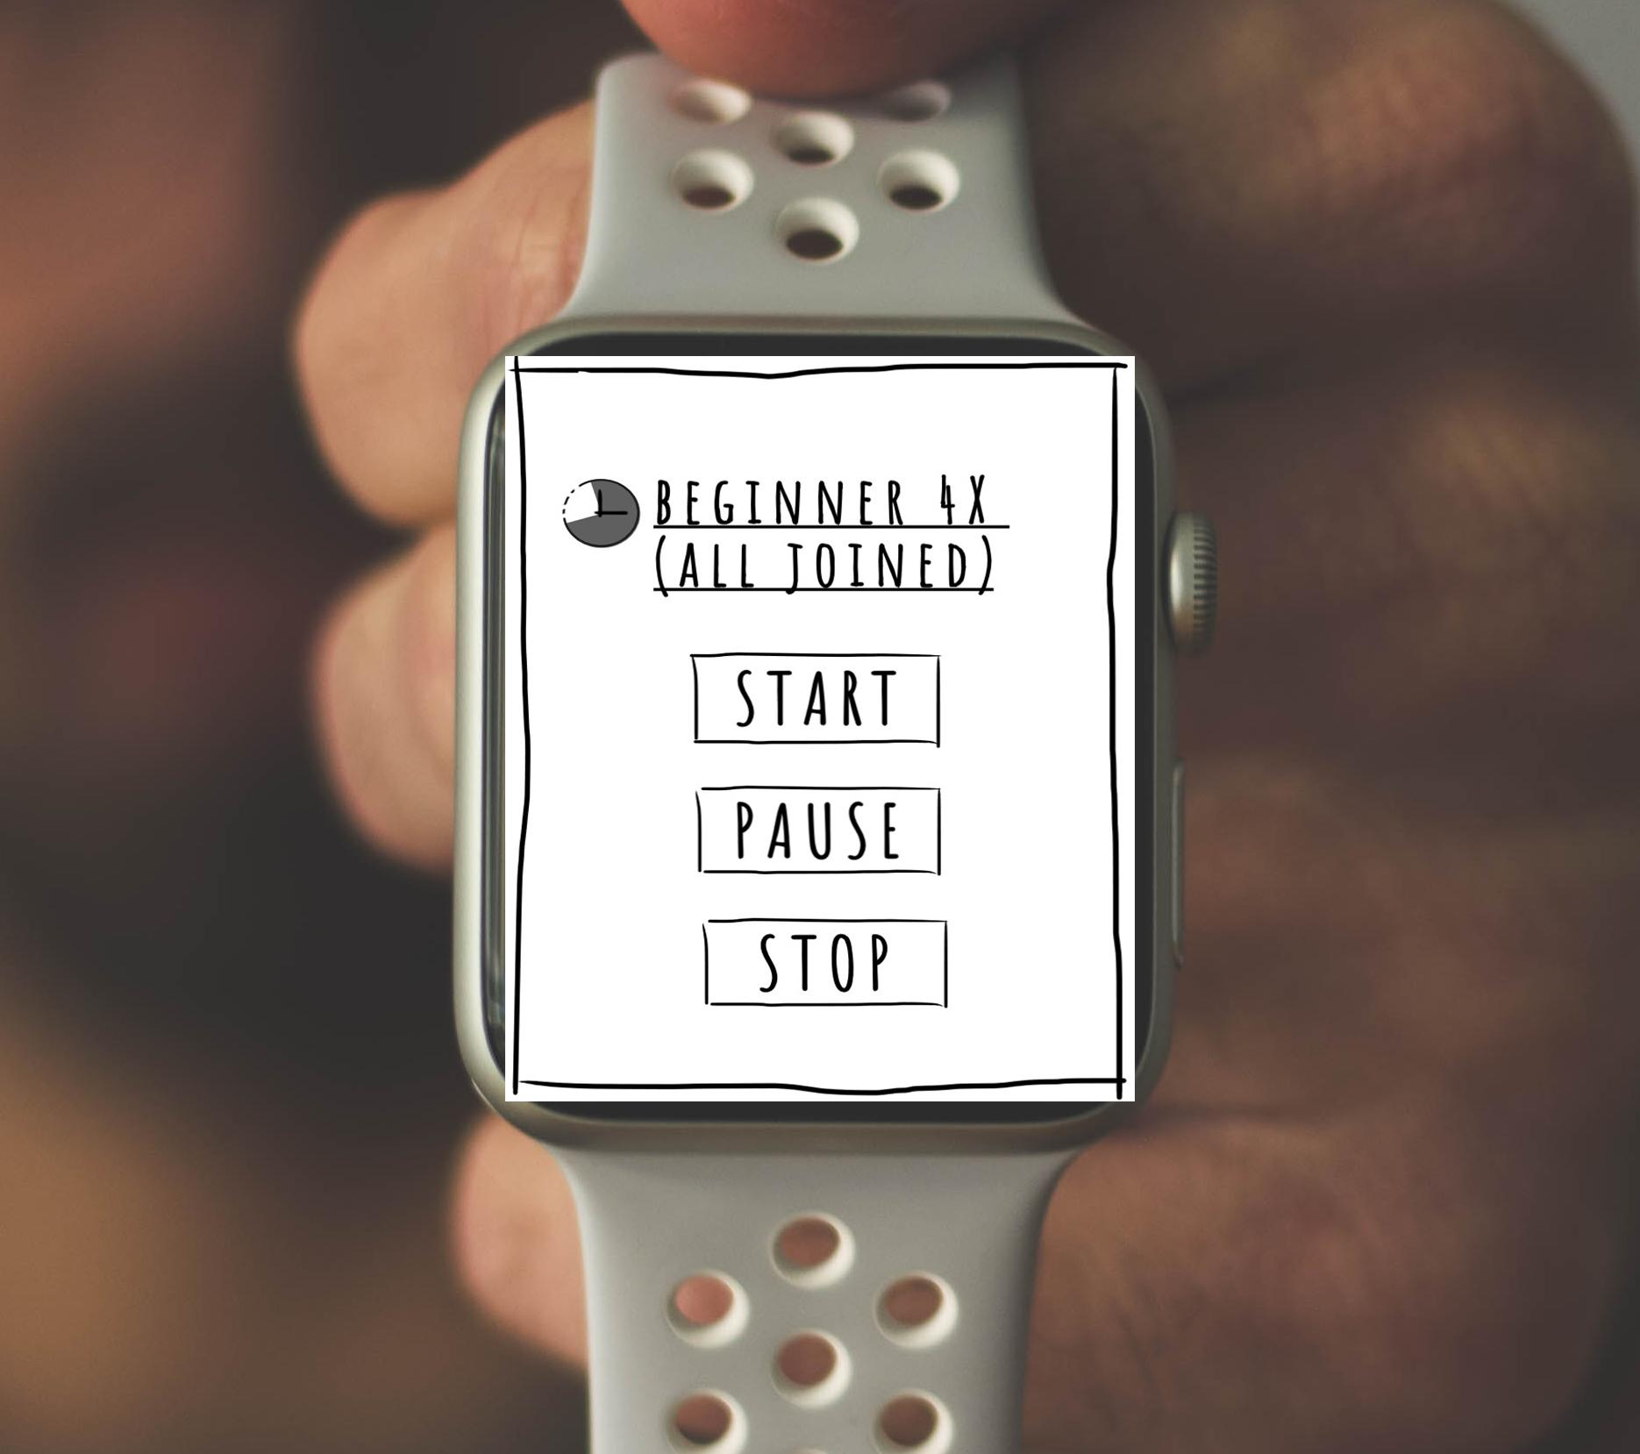
1 SCENARIO - BEGINNER
Smartwatch interface

Slide 21
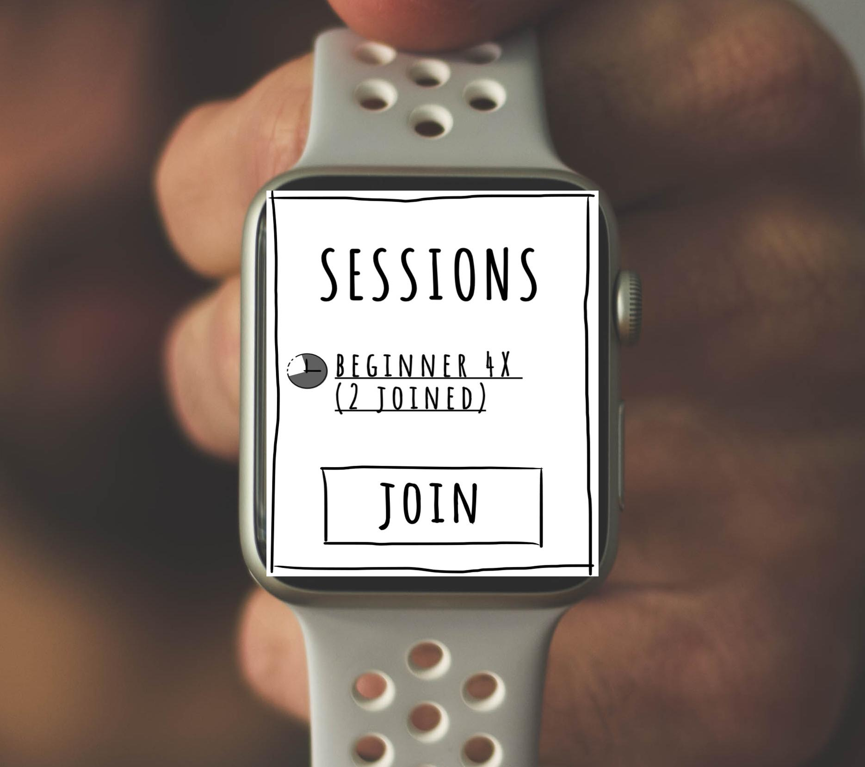
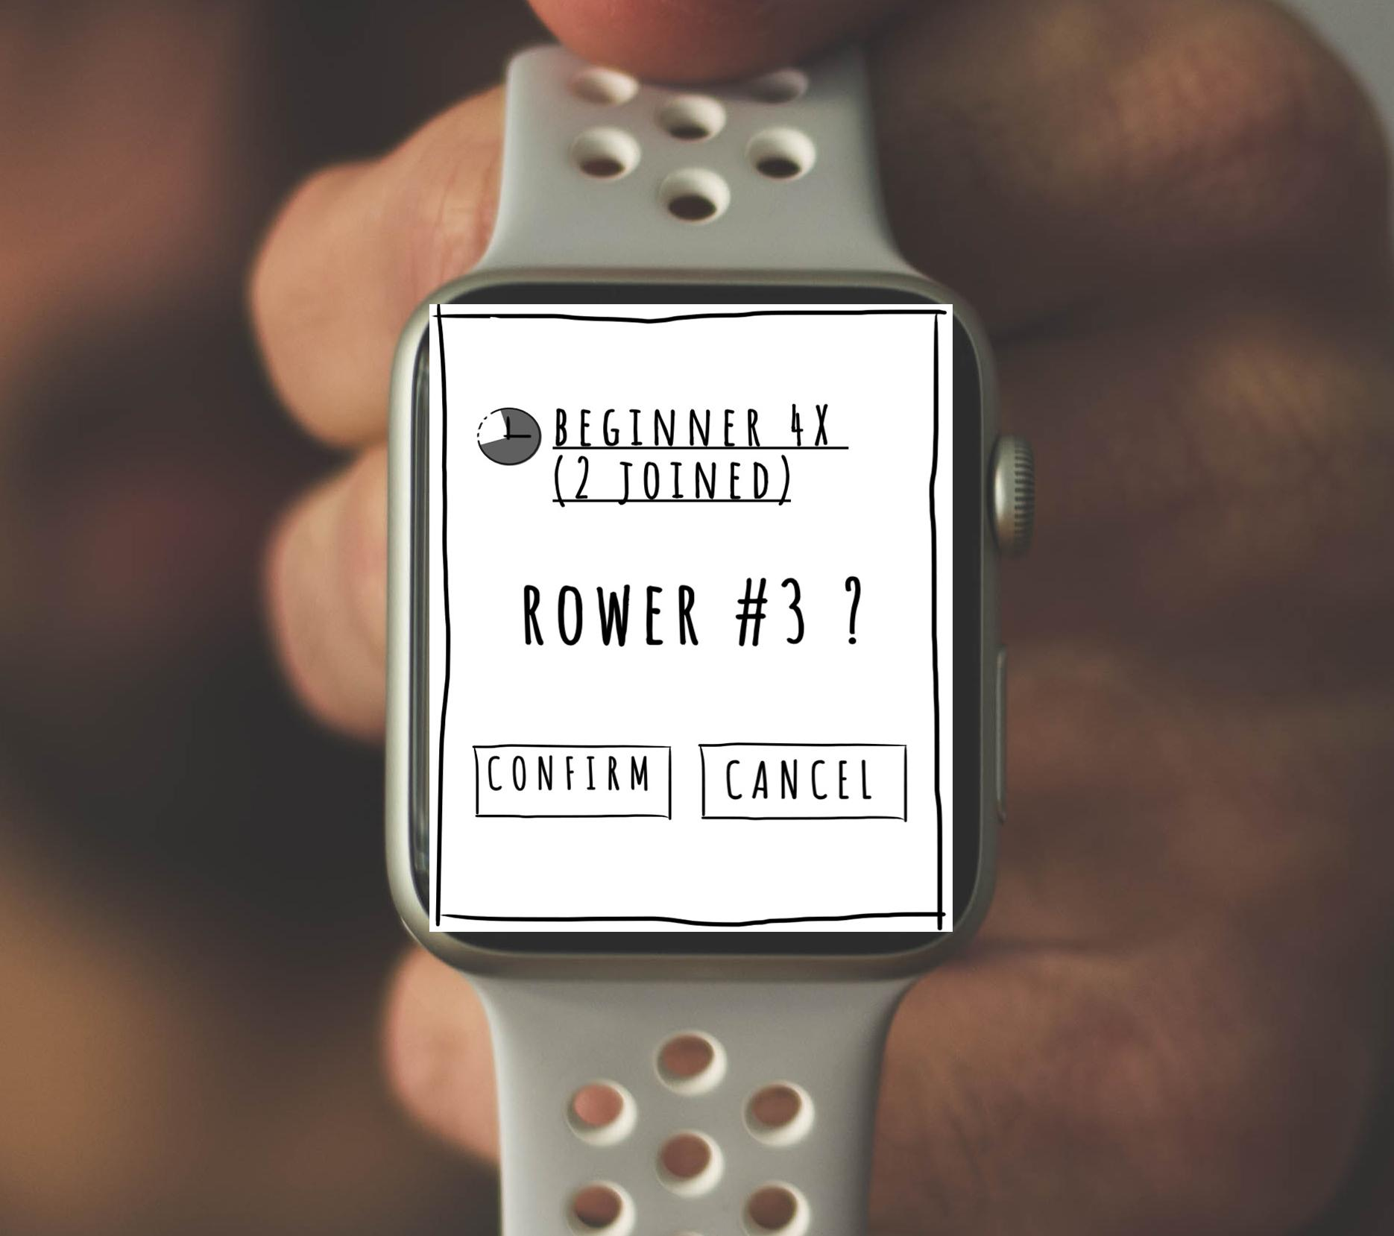
1 SCENARIO - BEGINNER
Smartwatch interface

Slide 22
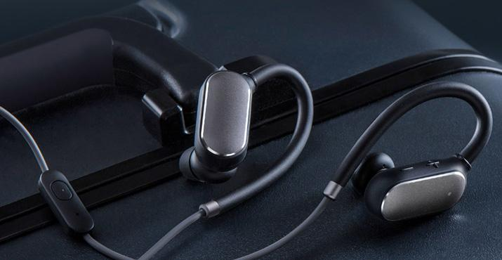
1 SCENARIO - BEGINNER
Auditory Feedback
Used for synchronization
Environment sounds are masked
Played continuously
For single rower:
Rower’s motion as a feedback
Hand mis-synchronization detection using directional sound
In Teams:
Leader’s motion as a feedback
A guidance to follow for other rowers

Slide 23

1 SCENARIO - BEGINNER
Haptic Feedback
Used for movements correction
Feedback of deviations in upper body movements
Given when the rower moves incorrectly
Amplitude encoded in vibration intensity
Direction encoded using the specific vibrotactile point
(e.g. elbow point -> arms too close to the body
wrist upper/lower point -> the oar
above/below the ideal trajectory)

Slide 24

1 SCENARIO - BEGINNER
Web-based interface

Slide 25
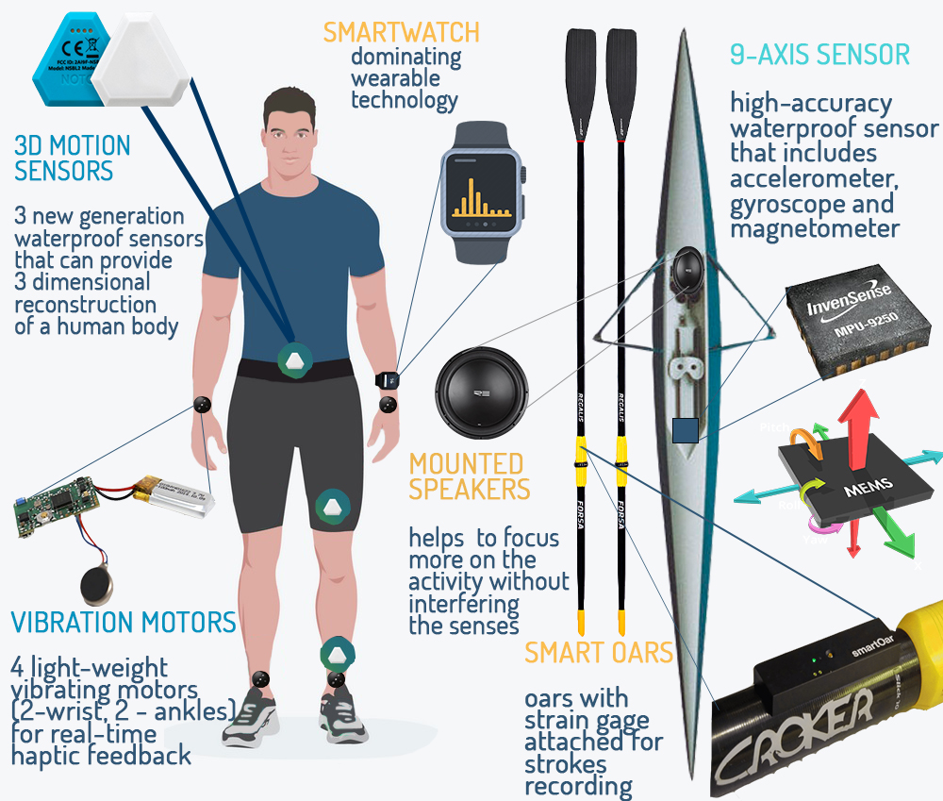
2 SCENARIO -
EXPERT
SmartWatch - setting the session
9-Axis sensor - accurate boat measurements
Smart Oars - stroke recording
Boat mounted speakers.
Vibration motors - water enter synchronization feedback & push starting point[5]

Slide 26
2 SCENARIO - EXPERT
Smartwatch interface

Slide 27
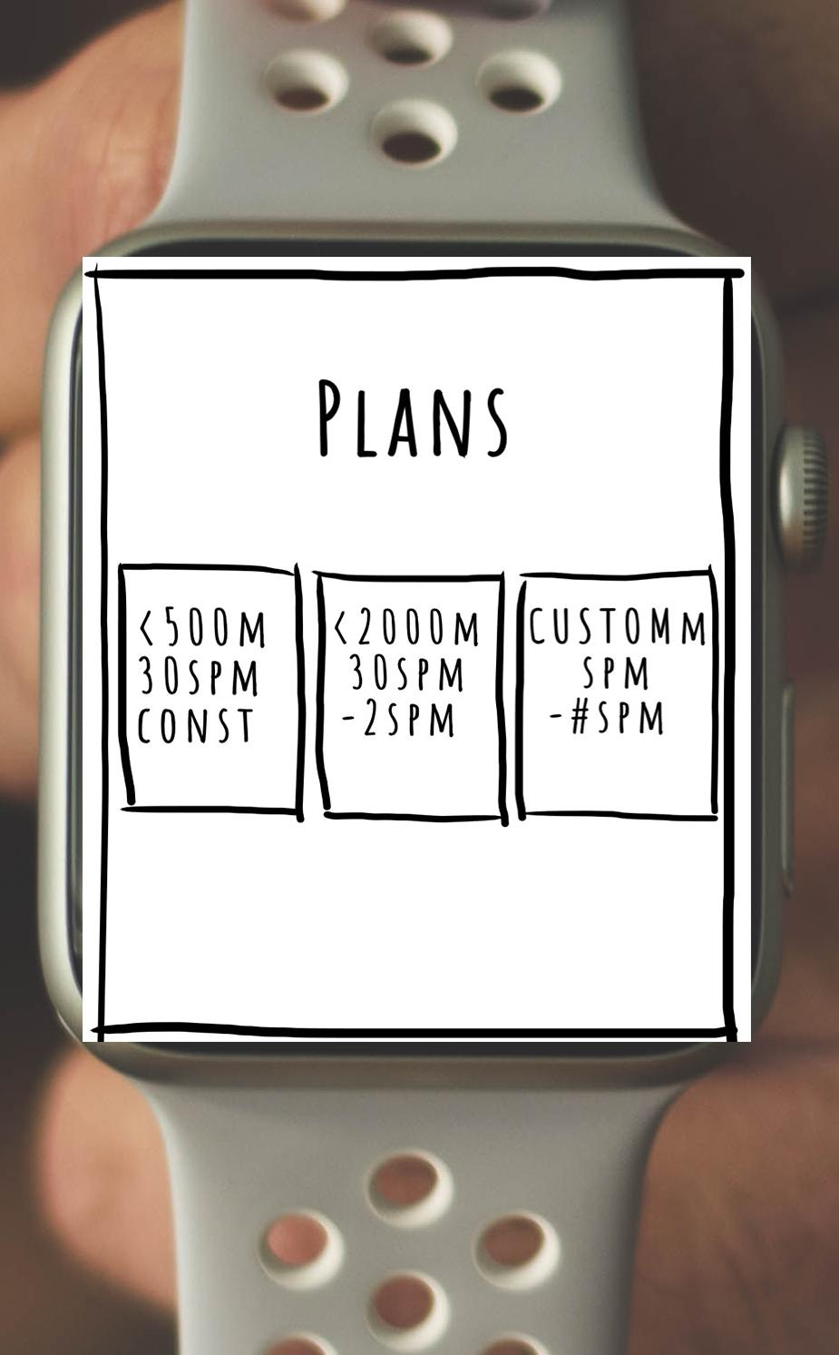
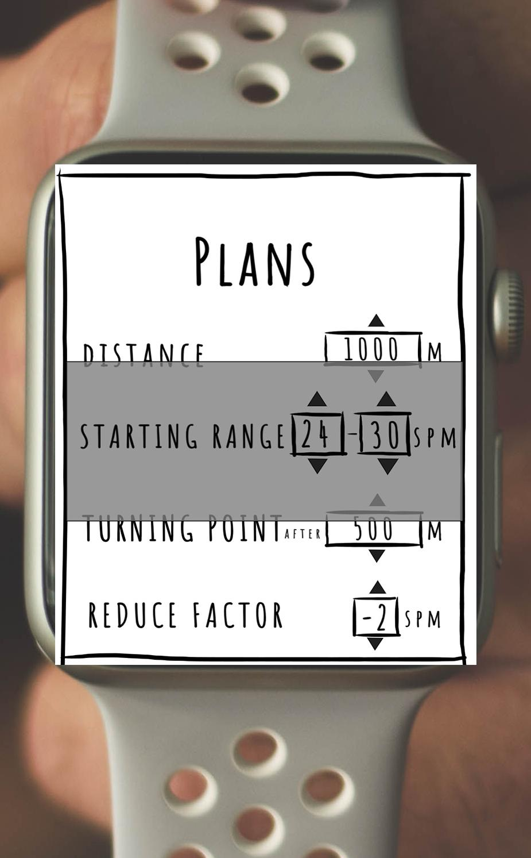
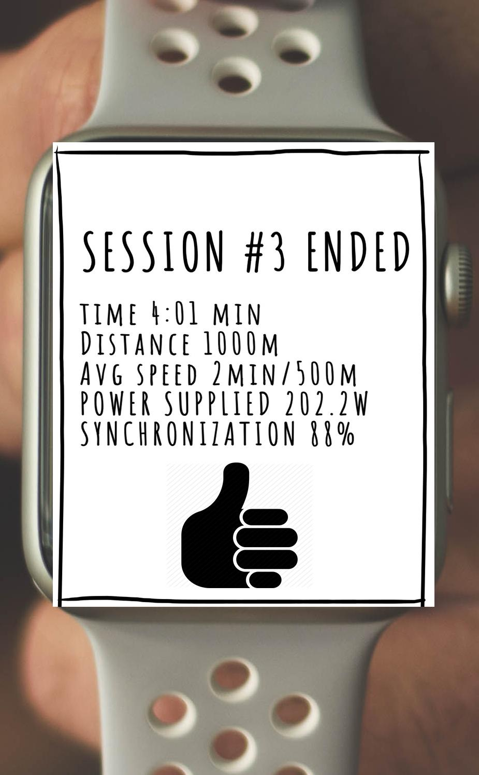
2 SCENARIO - EXPERT
Smartwatch interface

Slide 28
2 SCENARIO - EXPERT
Auditory Feedback
Used for synchronization
Played continuously
Target stroke-per-minute
Amplitude modulated with boat acceleration
@20 SPM
@25 SPM
@30 SPM

Slide 29
2 SCENARIO - EXPERT
Haptic Feedback
Used for increasing synchronization and performance
Synchronization
Wrist vibration
Performance
Perfect knee angle for starting push point

Slide 30
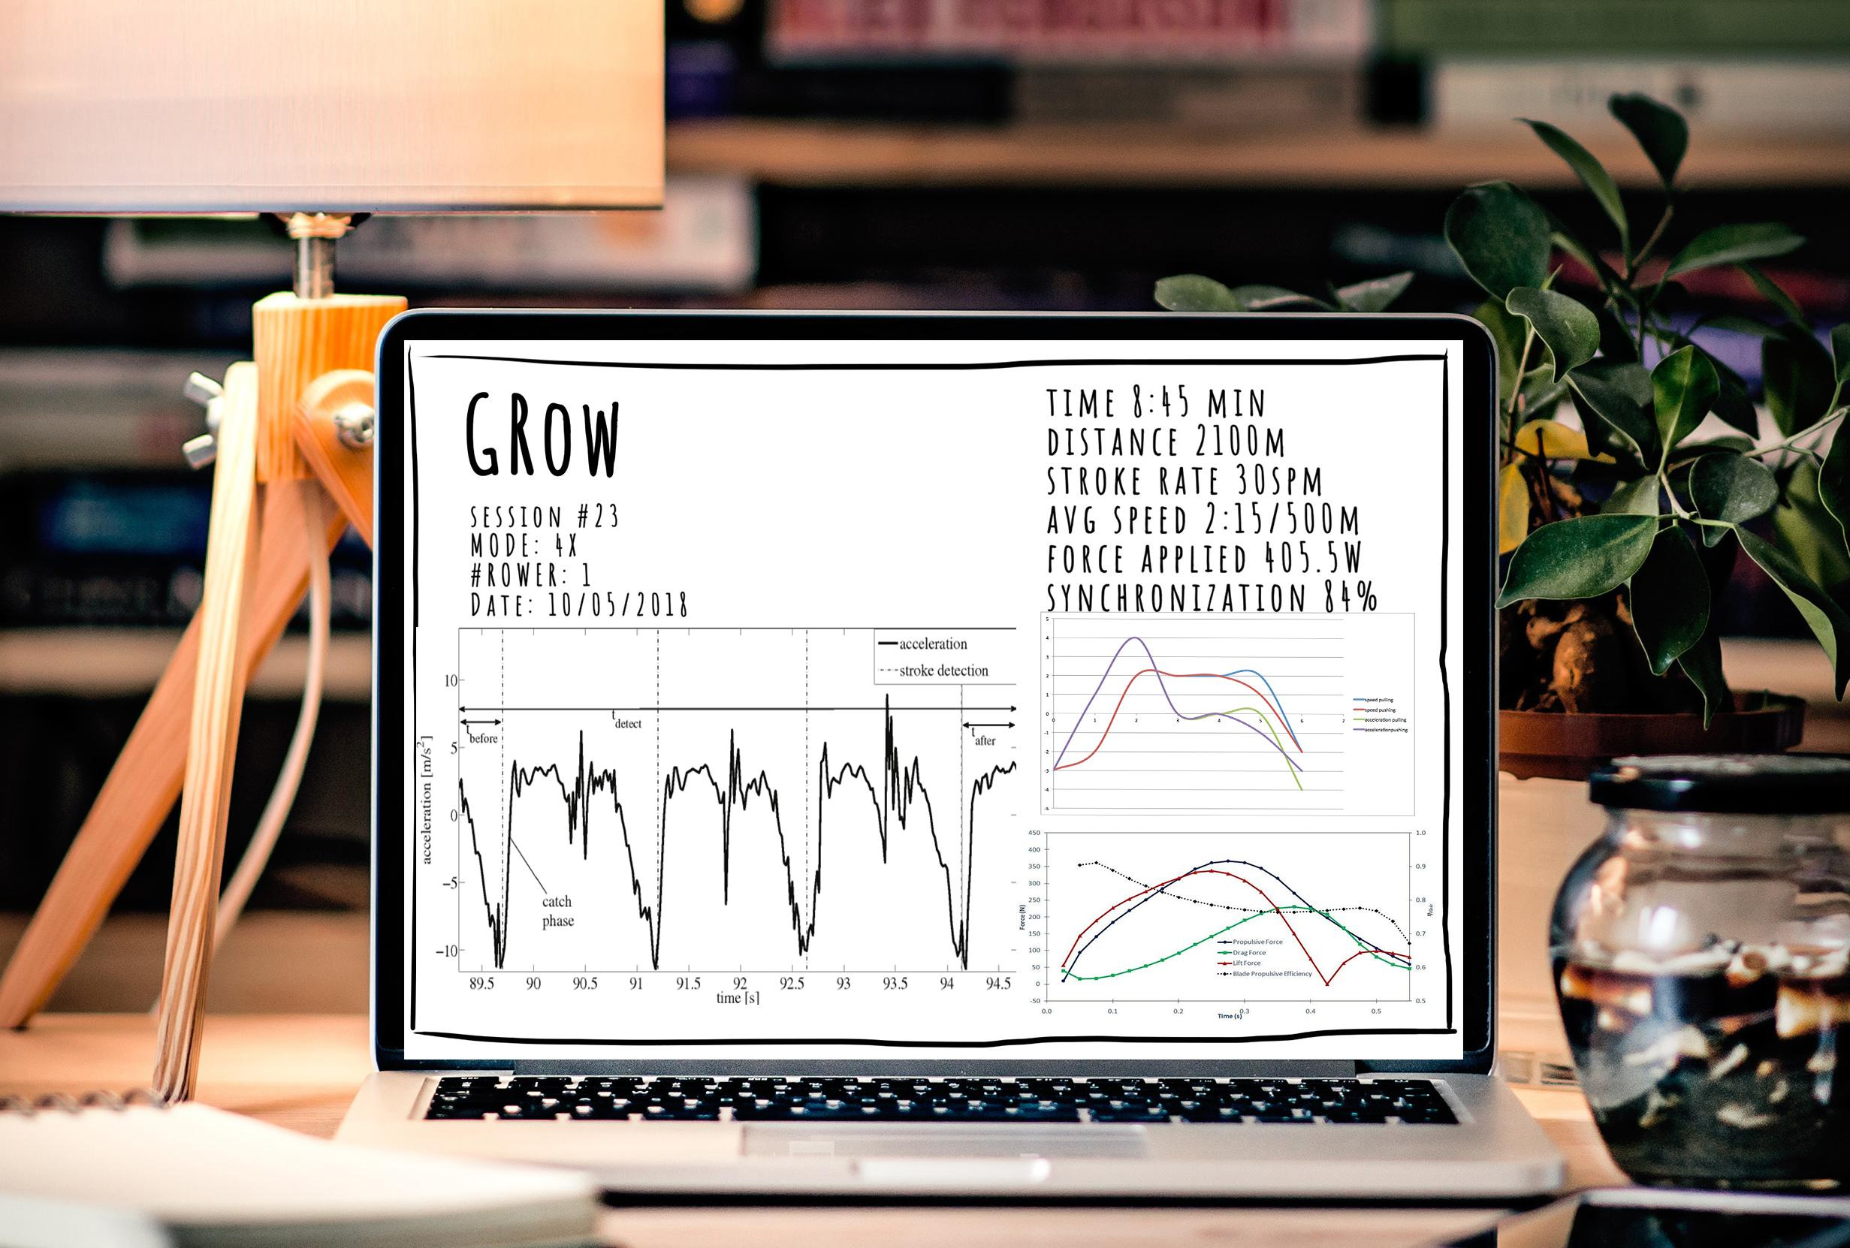
2 SCENARIO - EXPERT
Web-based interface

Slide 31

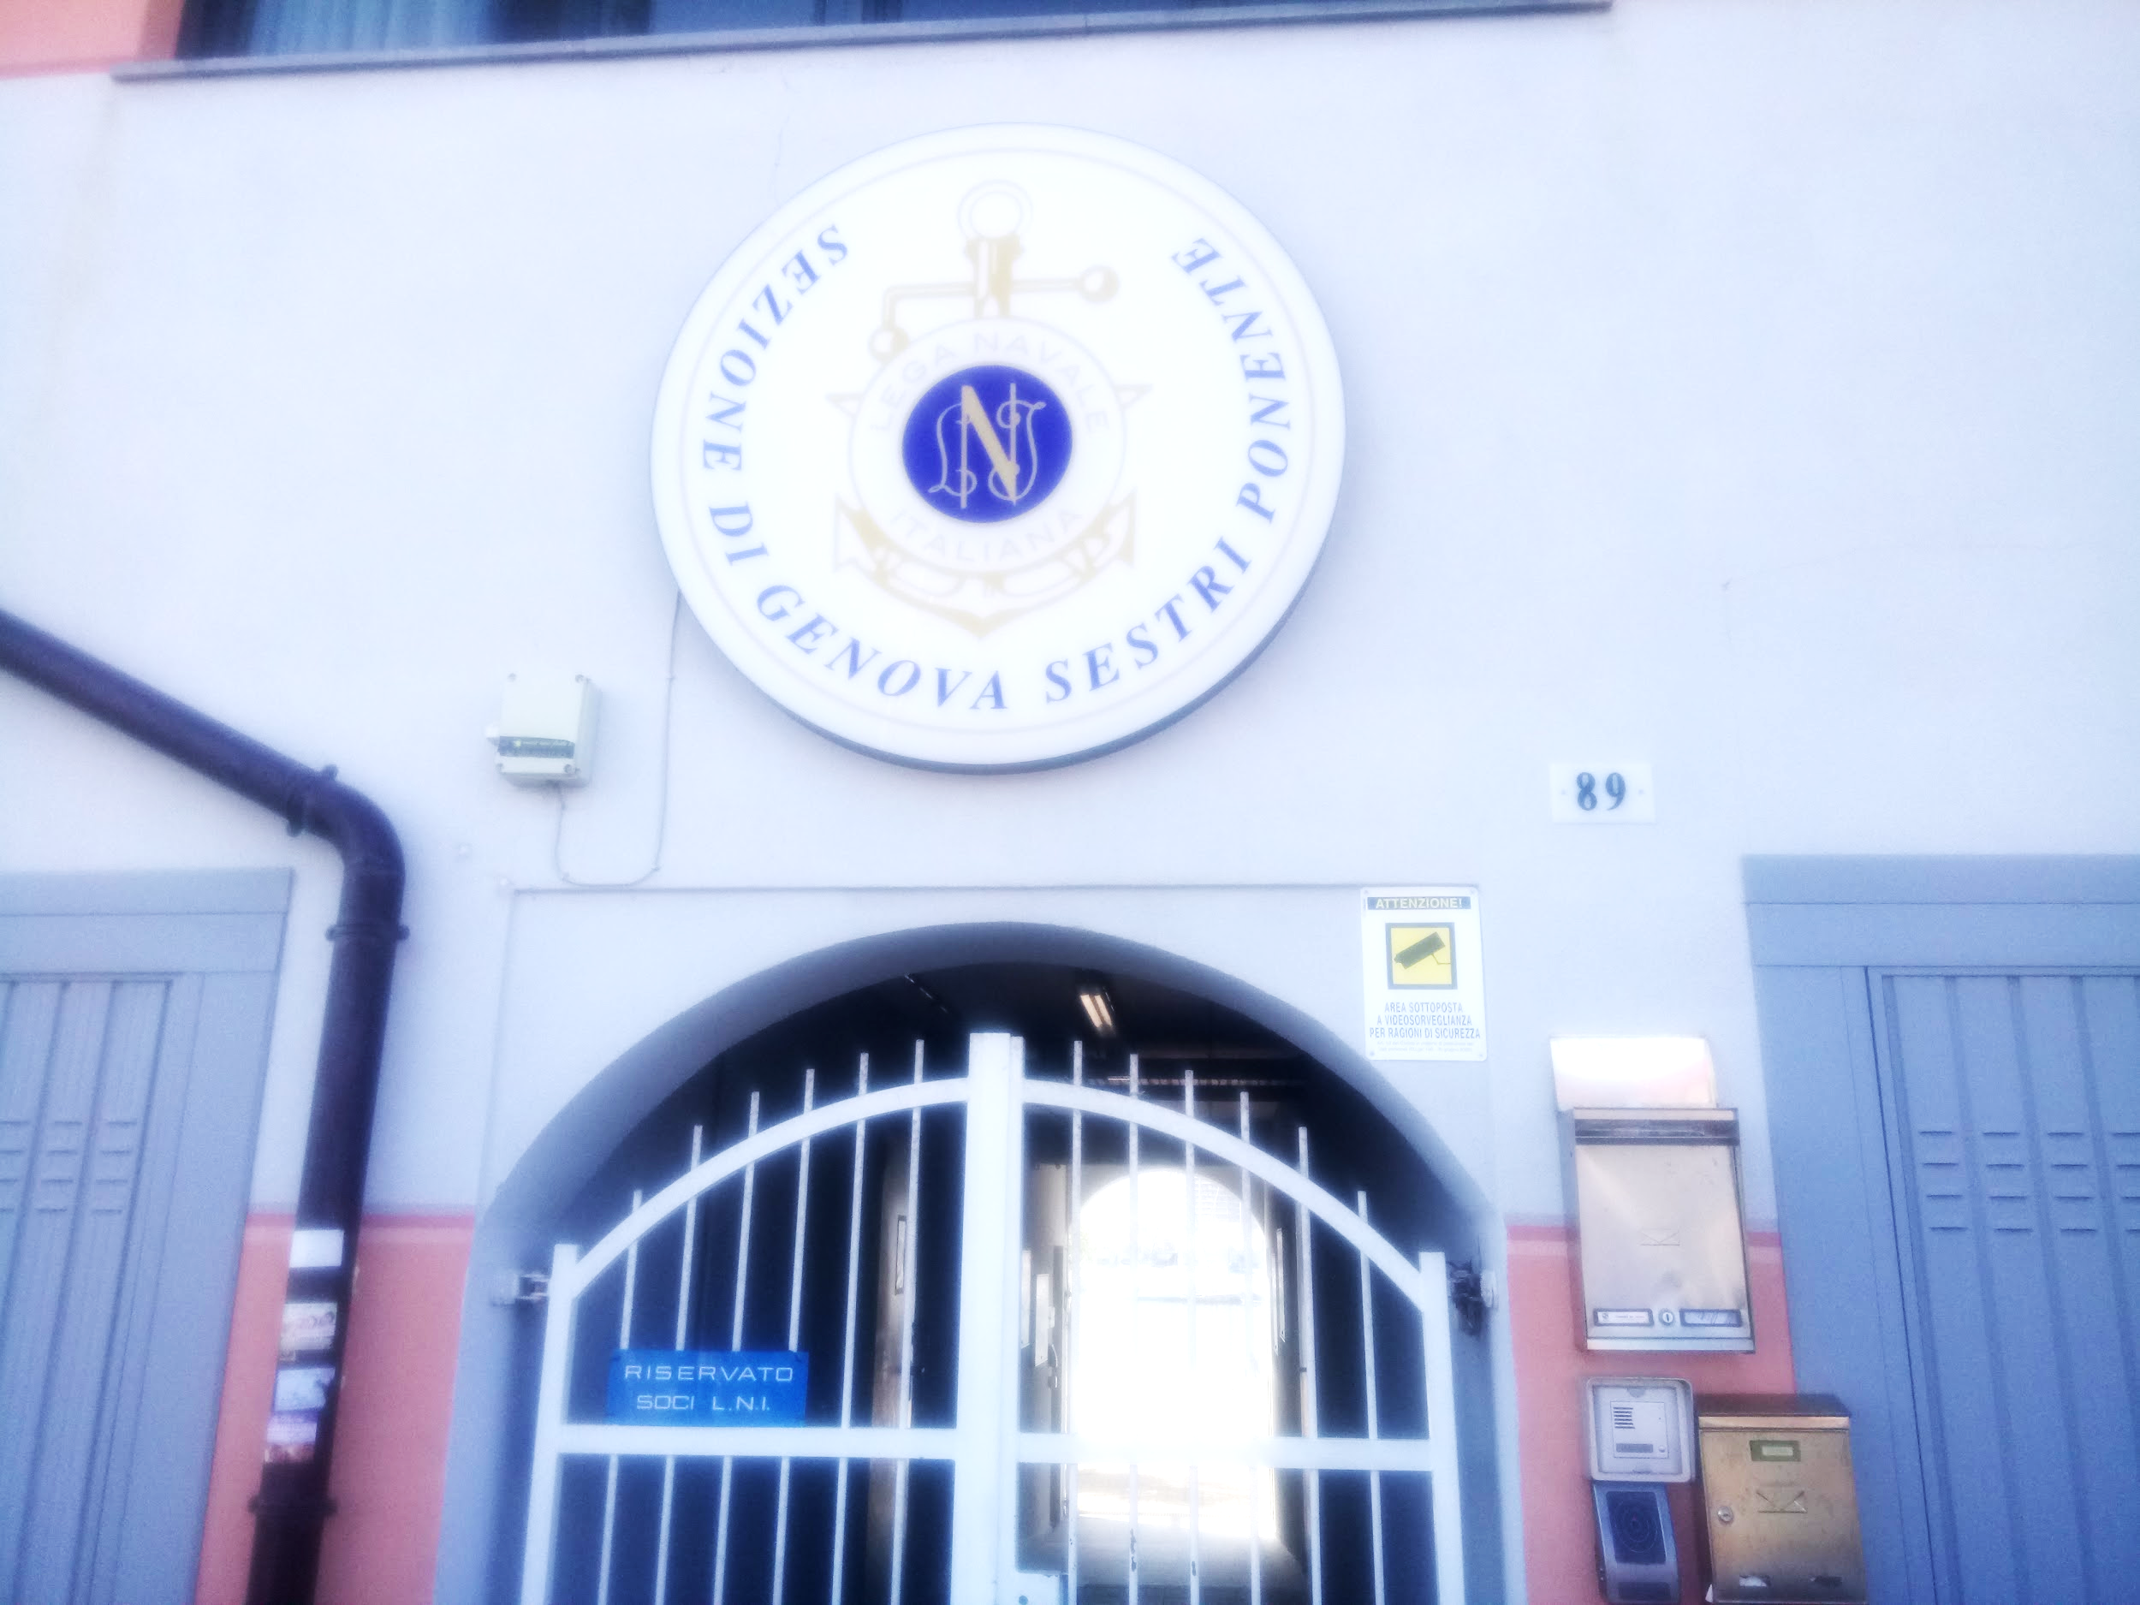
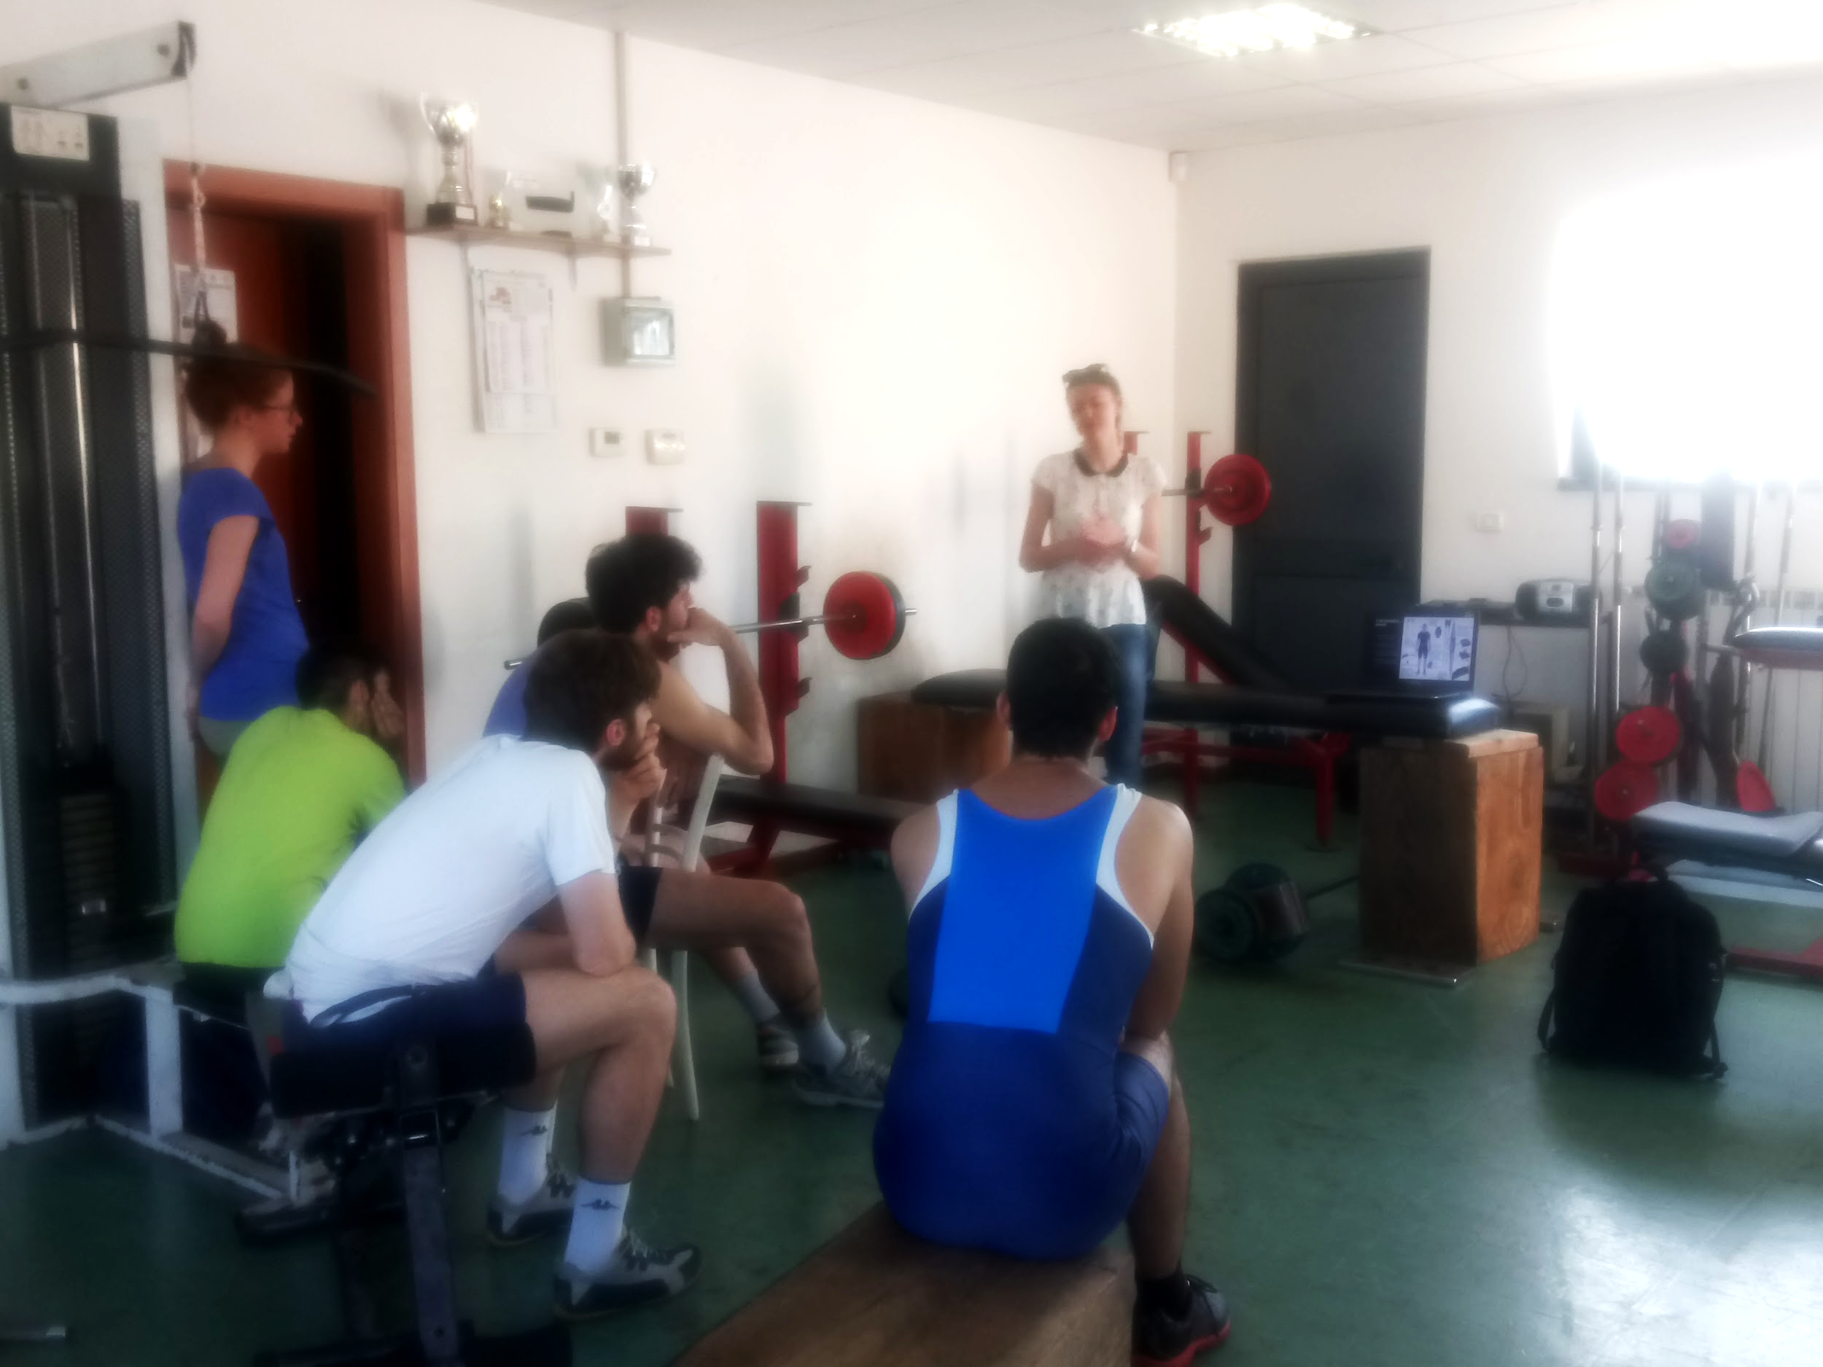
EVALUATION
Presentation for expert rowers in Sestri Ponente
Questionnaires filled in by experts and beginners
Specific questions of interest
UEQ Analysis (User Experience)[6]
Total of 17 samples

Slide 32
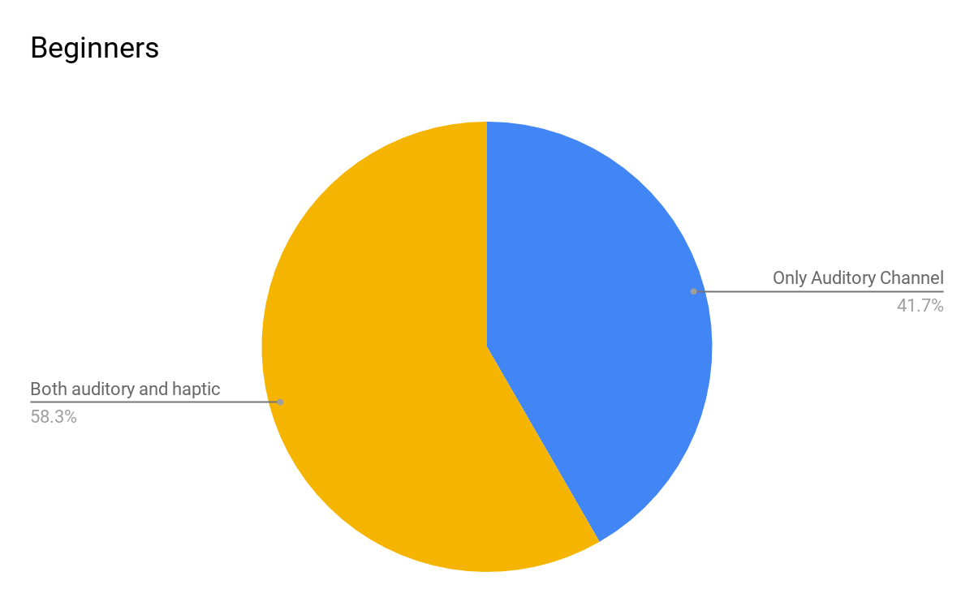
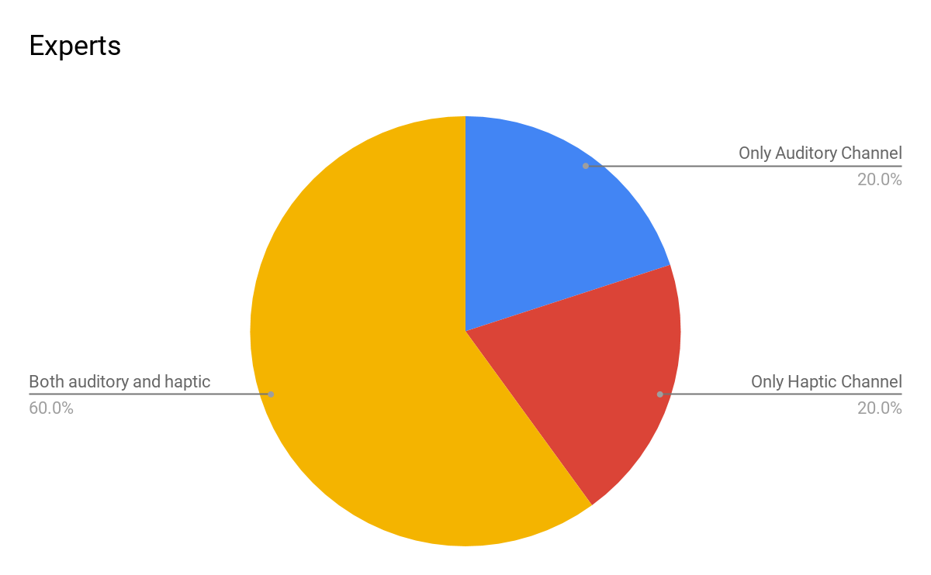
RESULTS
depending on the feedback design, which channels are more suitable to use, in your opinion

Slide 33
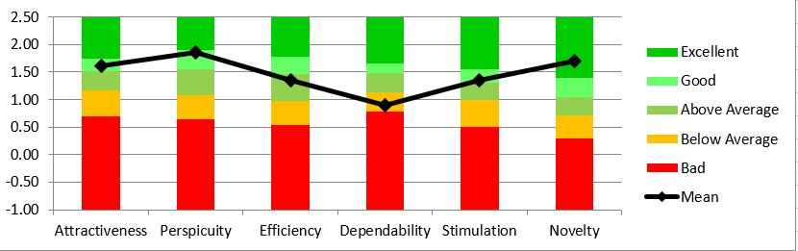
RESULTS
Experts Questionnaire
Alpha Correlation | 0.98 | 0.93 | 0.65 | 0.81 | 0.91 | 0.93

Slide 34
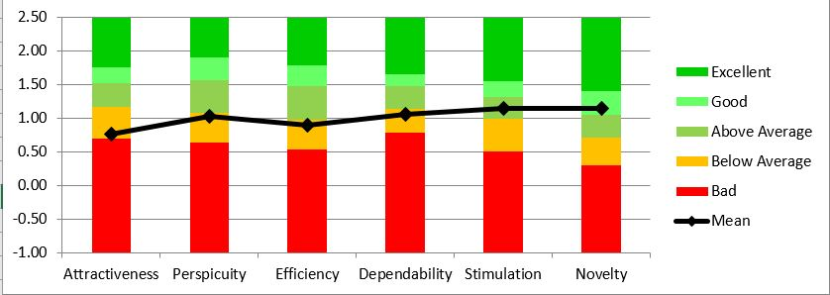
RESULTS
Beginner Questionnaire
Alpha Correlation | 0.89 | 0.88 | 0.81 | 0.45 | 0.89 | 0.58

Slide 35

POSSIBLE FUTURE PLAN
Alternativechoice of technology
Getting real data
Experiments with beginners and experts
Further evaluations during&after trial
Mapping the data into feedbacks

Slide 36

THANK YOU FOR ATTENTION!
Any Questions?

Slide 37
REFERENCES
References:
[1] N. Schaffert and K. Mattes, "Interactive Sonification in Rowing: Acoustic Feedback for On-Water Training," in IEEE MultiMedia, vol. 22, no. 1, pp. 58-67, Jan.-Mar. 2015.
[2] S.Nina & M.Klaus, Influence of acoustic feedback on boat speed and crew synchronization in elite junior rowing. International Journal of Sports Science & Coaching. 2016.
[3] C.Daniel, S.Nina, M.Carlo, M.Klaus, A. Marco. AccrowLive: A Multiplatform Telemetry and Sonification Solution for Rowing. Procedia Engineering, 2014.
[4] S.Roland, R.Georg, M. Laura, R.Robert, W.Peter “Sonification and haptic feedback in addition to visual feedback enhances complex motor task learning”, in Experimental Brain Research vol. 223, pp. 909-925, Mar.2015
[5] E. Ruffaldi, M. Bergamasco, and S. S. S. Anna, “Vibrotactile Perception Assessment for a Rowing Training System,” pp. 350–355, 2009.
[6] M. Rauschenberger, M. S. P. Medien-systempartner, M. Schrepp, S. A. P. Ag, M. P. Cota, and S. Olschner, “Efficient Measurement of the User Experience of Interactive Products . How to use the User Experience Questionnaire ( UEQ ). Example : Spanish Language Version,” Int. J. Interact. Multimed. Artif. Intell., vol. 2, pp. 39–45, 2013.
Useful Links:
http://www.sofirow.de/english.html
http://www.accrow.de/englisch.html
https://www.rowinginmotion.com/pricing/
http://www.rowingperformance.com/user-guide-and-q-and-a
http://www.concept2.com/service/software/other-apps
http://www.technologist.eu/the-sports-revolution/
G.P. Kenyon and M.H. Thaut, “Rhythmic-driven Optimization of Motor Control”. Rhythm,music and the brain: Scientific Foundations and Clinical Applications, M.H. Thaut, ed.,New York: Routledge Chapman & Hall, 2008, pp.85-112.
https://www.statista.com/statistics/189562/daily-engagement-of-the-us-poppulation-in-sportsand-exercise
https://crossfitrowingblog.com/2015/04/24/breathing-technique-for-rowing/

